Slide 1
BOM & Storage: Window, navigator, location, Alerts, pop-ups, timers, Web Stroage- LocalStorage, SessionStorage, Cookies.
Department of Computer Science and Engineering
Chitkara University, Punjab

Slide 2
Contents
Window Object
Navigator
Location
Alerts & Pop-ups
Timers
Web Storage (LocalStorage, SessionStorage)
Cookies

Slide 3
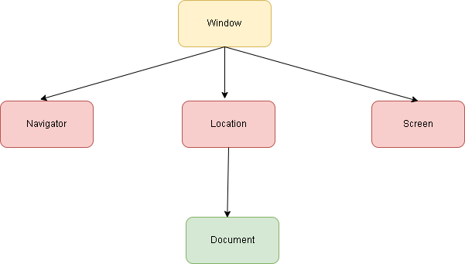
Browser Object Model (BOM)
BOM stands for Browser Object Model
It allows JavaScript to interact with the browser
Represents the browser window and its components
Provides access to:
URL (location)
Browser details (navigator)
Screen information
Storage

Slide 4
Real-Life Example:
Redirecting user to another page after login
Checking if user is online/offline
Showing alerts or pop-ups

Slide 5
Window Object in JavaScript
Represents the browser window
It is the global object in JavaScript
All variables and functions are part of window
You can access it explicitly or implicitly
Syntax:
window.property
window.method() Examples:
console.log(window.innerHeight);
console.log(window.innerWidth); console.log(innerHeight); //window is optional

Slide 6
Real-Life Example:
Adjust layout based on screen size
Detect browser window dimensions for responsive design

Slide 7
Window Methods: User Interaction
Used to interact with users
Built-in methods of the window object
Common methods:
alert()
confirm()
prompt()
1. Alert Box
Displays a message
alert("Welcome to the website");

Slide 8
2. Confirm Box
Returns true / false
let x = confirm("Do you want to continue?");
console.log(x);
OK → true
Cancel → false

Slide 9
Navigator Object in JavaScript
Provides information about the browser
Helps detect device, browser, and connection status
Part of the BOM (child of window)
Common Properties:
navigator.userAgent → Browser details
navigator.language → Language of browser
navigator.onLine → Internet status (true/false)
Examples: console.log(navigator.userAgent);
console.log(navigator.language);
console.log(navigator.onLine);

Slide 10
Real-Life Example:
Show message when user is offline
Customize UI based on browser
Detect mobile vs desktop users

Slide 11
Location Object in JavaScript
Provides information about current URL
Used for navigation and redirection
Part of window object Common Properties:
location.href → Full URL
location.hostname → Domain name
location.pathname → Page path

Slide 12
Examples:
console.log(location.href);
console.log(location.hostname); Redirection Example:
location.href = "https://google.com";
Real-Life Example:
Redirect user after login
Navigate to payment page
Reload or change page dynamically

Slide 13
Alerts and Pop-ups
Used to interact with users
Display messages or take input
Methods belong to window object
Types:
alert() → Message box
confirm() → OK/Cancel
prompt() → User input

Slide 14
Examples:
alert("Welcome!");
let x = confirm("Delete item?");
console.log(x);
let name = prompt("Enter name:");
console.log(name);
Real-Life Example:
Confirmation before deleting data
Asking user details
Showing warnings

Slide 15
Pop-up Windows
Used to open new browser windows/tabs
Controlled using window.open()
Syntax:
window.open(url, name, specs);
Example:
window.open("https://example.com");
Close Window:
window.close();
Real-Life Example:
Opening payment gateway
Showing external links
Login popup window

Slide 16
Timers in JavaScript
Timers: setTimeout()
Executes code after a delay
Runs only once
Syntax:
setTimeout(function, time);
Example:
setTimeout(function(){console.log("Hello after 2 seconds");}, 2000);
Real-Life Example:
Show notification after delay
Auto logout warning
Delayed message display

Slide 17
Timers: setInterval()
Executes code repeatedly
Runs after fixed intervals
Syntax:
setInterval(function, time);
Example:
let id = setInterval(function(){console.log("Running...");}, 1000);

Slide 18
Stop Interval:
clearInterval(id);
Real-Life Example:
Clock updates every second
Auto-refresh data
Live notifications
Key Point:
It is Used for repeated execution

Slide 19
Web Storage in JavaScript
Used to store data in browser (client-side)
Data is stored as key–value pairs
No server/database required
Faster than cookies
Types of Web Storage:
LocalStorage → Permanent
SessionStorage → Temporary Real-Life Example:
Save theme (dark/light mode)
Store shopping cart items
Remember user preferences

Slide 20
LocalStorage
Stores data permanently
Data remains even after browser is closed
Shared across tabs (same website) Syntax:
localStorage.setItem("key", "value"); Example:
localStorage.setItem("name", "Rohan");
let x = localStorage.getItem("name");
console.log(x);

Slide 21
Remove Data:
localStorage.removeItem("name");
localStorage.clear();
Real-Life Example:
Save “Remember Me” login
Store user settings

Slide 22
SessionStorage
Stores data temporarily
Data is deleted when tab is closed
Not shared across tabs
Syntax:
sessionStorage.setItem("key", "value");
Example:
sessionStorage.setItem("user", "Admin");
let x = sessionStorage.getItem("user");
console.log(x);
Real-Life Example:
Store login session
Temporary form data
One-time activity tracking

Slide 23
Cookies
Small data stored in browser
Sent to server with every request
Used for authentication & tracking Syntax:
document.cookie = "username=Rohan";
Example with Expiry:
document.cookie = "age=22; expires=Fri, 31 Dec 2026 12:00:00 UTC";

Slide 24
Real-Life Example:
Login authentication
User tracking
Remember user sessions
Key Point:
Cookies connect browser with server.

Slide 25
Thank You

